Slide 1
Assignment 2: Machine learning with Energy datasets
Team 10:
Jai Soni
Pramod Nagare
Saurabh Kulkarni

Slide 2
Part 2 : Exploratory Data Analysis

Slide 3
Dataset Overview:
IOT Dataset for appliance energy consumption.
Data available for 11/01/2016 to 27/05/2016 with 10 min interval.
Number of rows: 19735
Total number of columns: 29
We have 0% missing values in our dataset.
Date feature has a data type Object. We have numerical dataset.
Various temperature and humidity features available for each record.
Also, windspeed, visibility and pressure readings are given.

Slide 4
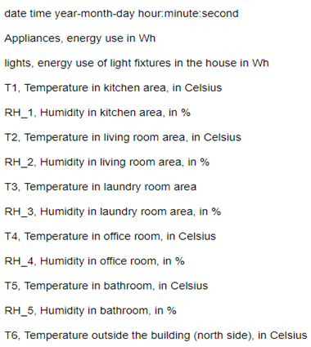
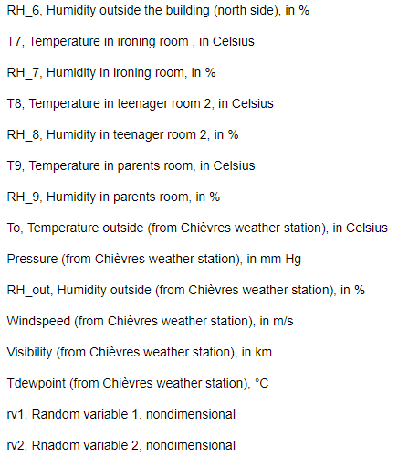
Variable Description

Slide 5
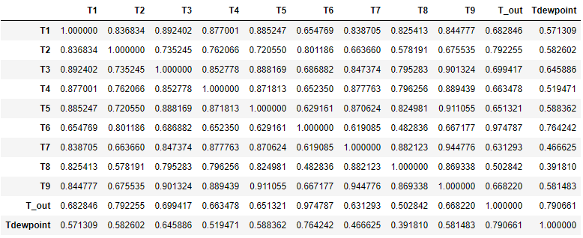
Temperature Variable Analysis
Almost all temperature feature ranges between 14.89°C to 29.86°C
Exceptions:
T6, Tdewpoint and T_out is ranges between -6.6°C to 28.9°C.
Reason: T6 and T_out are temperature outside the building.
All the temperature features are correlated with each other.

Slide 6
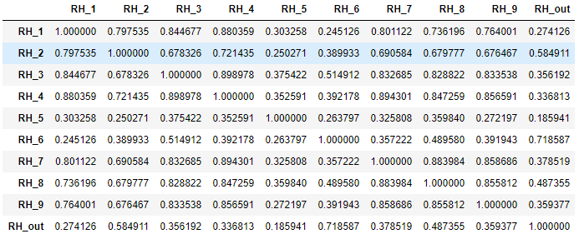
Humidity Variable Analysis
Almost all humidity features ranges between 20.46% to 63.36%
Exceptions:
RH_5 & RH_out: 24% to 100%
RH_6: 1% to 99.9%
Reason:
RH_5: Humidity recorded at the bathroom.
RH_6 and RH_out: Humidity recorded at outside of building.
RH_1, RH_2, RH_3, RH_4, RH_7, RH_8, RH_9 has significant correlation with each other and very less correlation to other humidity features.

Slide 7
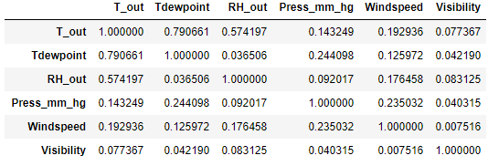
Weather variable analysis
Pressure data ranges from 729.3 mmHg to 772.30 mmHg
Windspeed recorded ranges from 0 to 14 m/s
Visibility data ranges from 1 to 66 kms.
These features has very low correlation among each other.

Slide 8
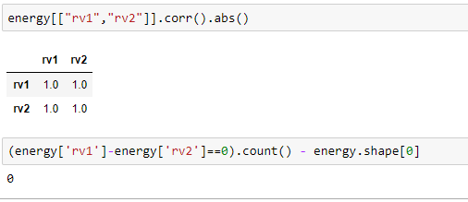
Random variable analysis
Features rv1 and rv2, 2 random variable which was just added to validate the performance of the feature selections models.
We found the perfect correlation between these two variables.
Also, it is proved that the both columns are identical, giving redundancy in the dataset.

Slide 9
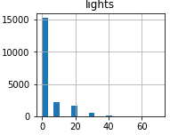
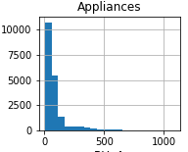
Target variable analysis
We can see that Maximum appliance consumption is 1080 Wh.
However, we have 90.21% of data for which the appliance energy consumption is less than 200 Wh.
Similarly, the maximum lights consumption is 70 Wh.
But 77.28% of data shows that the lights were off.
This observations show that there are less number of cases when the appliance energy consumption were high.

Slide 10
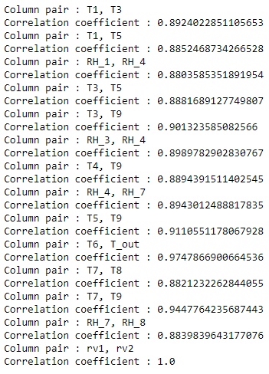
High Correlation Analysis (> 0.88)
rv1 and rv2 shows perfect correlation. And as derived in above observations, rv2 is redundant feature.
Feature T9 shows high correlation with T3, T4, T5, T7.
Thus T9 can be consider as a overhead in the dataset.
Similarly, T5 has a high correlation with the T9, T3 and T1 which thus acts added redundancy.
Also, we know T6 and T_out are exterior temperature features, and shows high degree of correlations.
We can get rid of either of the above two features to lower the data redundancy.

Slide 11
Time series analysis
As we have time series data, we can drill down our observation for time specific analysis for the appliance energy consumption.
For that we need to add some new features which will help us to get more insight.
We will add some more derived features like month, time, Day of week, NSM (minutes from midnight), DOY (Day of year), Only_Date
Also we need to scale our features to get effective visual graphs.

Slide 12
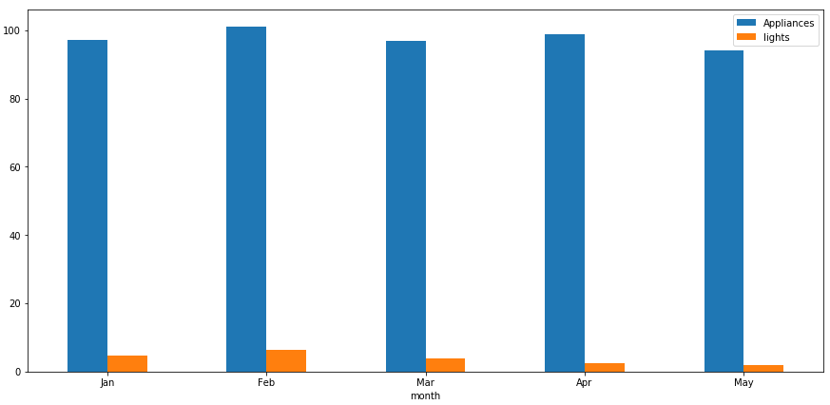
Appliance energy consumption over months
From the month January to February the appliance energy consumption increases and then decreases in the month of March.
Again the rise in the appliance energy increase in April and further drop in the month of May.
Similarly, there was a rise in the light usage for the month February and then gradual decrease in March, April and May.

Slide 13
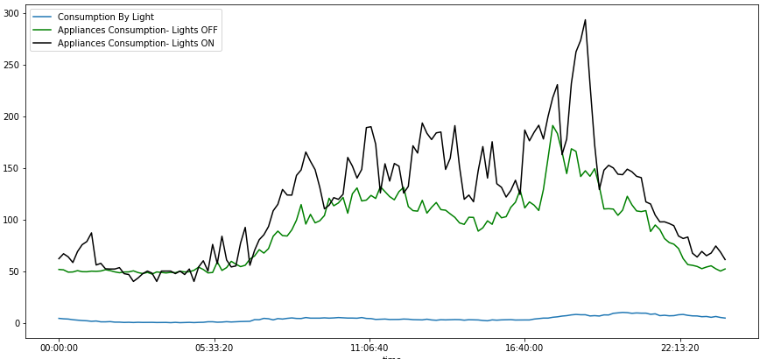
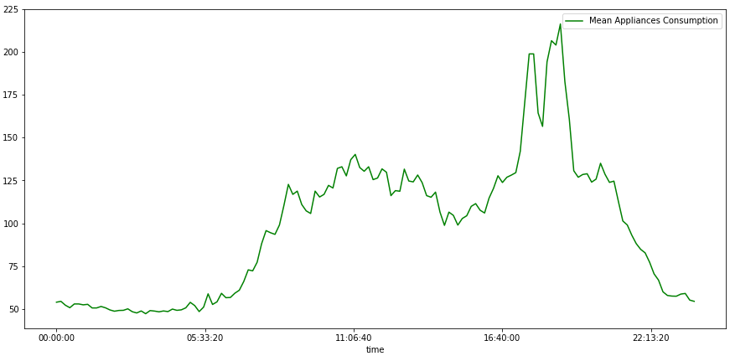
Appliance energy consumption with light status
(Average) Appliance energy utilizations is low when lights are OFF.
(Average) Appliance energy utilizations is high when lights are ON.
Also, Appliance energy utilizations follows a trend with respect to time.
For the night time (00:00:00 to 06:00:00) the energy consumption is lowest.
From the time 06:00:00 energy consumption started rising, and got steady till time 17:20:00
Then the peak hours started till 19:00:00
After that, the energy utilization started decreasing.

Slide 14
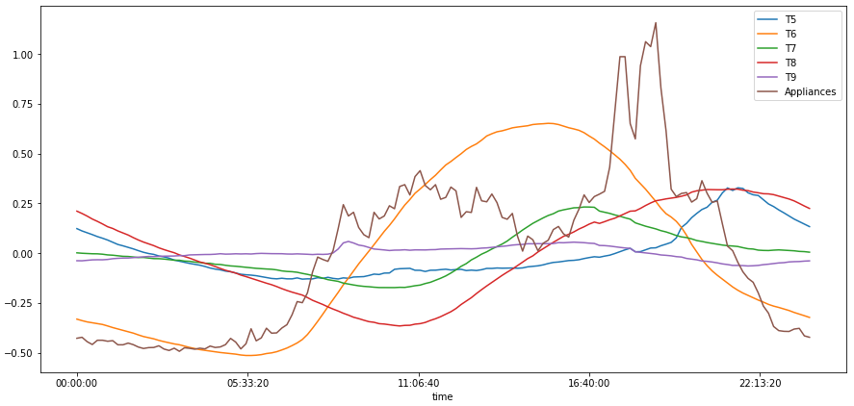
1st Floor Temperature Analysis
Features T1, T2, T3, T4 are the temperature belongs to the same floor but for different rooms.
From the above graph we can say that, Features T1, T2, T3, T4 Follows each other.
However, among all these features, T2 shows significant follow-up with the Appliances energy usage.

Slide 15
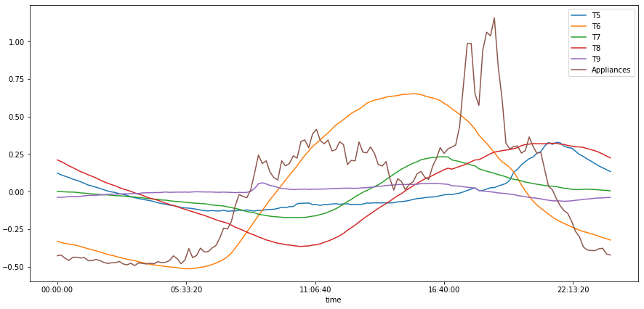
2nd Floor Temperature Analysis
Features T5, T6, T7, T8 and T9 are the temperature for the 2nd floor of the house.
Among all these features T6 shows the significant pattern for the Appliance energy utilization.

Slide 16
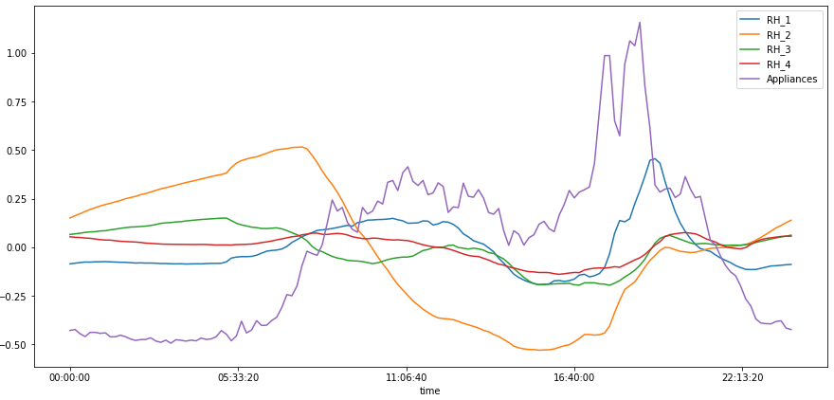
1st Floor Humidity Analysis
Plot shows the humidity for the different rooms on the 1st floor of the house.
All these features shows the significant pattern for the appliance energy consumption.

Slide 17
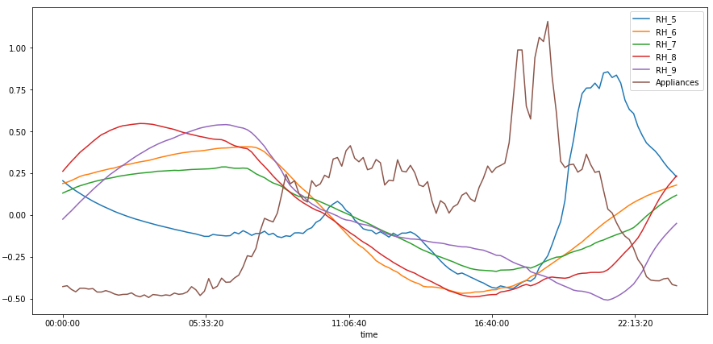
2nd Floor Humidity Analysis
The above plot shows the curve for the appliances energy utilization over time.
Among all these features RH_6, RH_7, RH_8 and RH_9 shows the great follow-up for the appliance energy utilization.

Slide 18
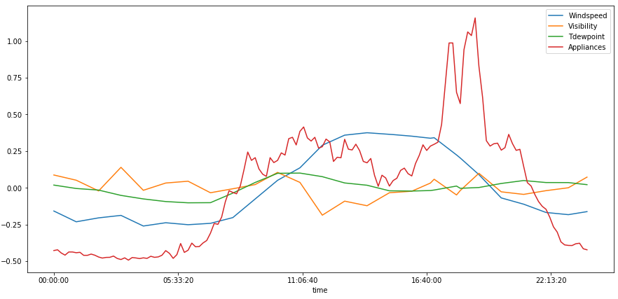
Windspeed, Visibility and Tdewpint Analysis
Features windspeed and Tdewpoint shows some significant follow-up pattern with the Appliances energy consumption.
Whereas, visibility does not shows any useful information for the energy prediction.

Slide 19
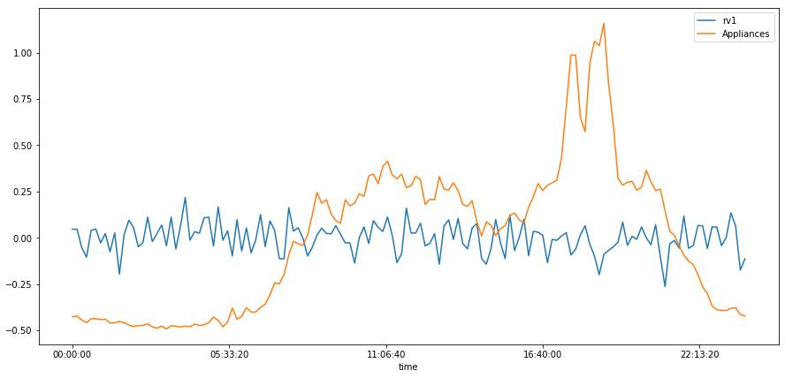
Random Variable Analysis
Feature rv1 does not have any specific pattern in the Appliances energy consumption over time.
It was just added to check the feature selection tools performance.

Slide 20
Part 3: Feature Engineering

Slide 21
Observations from EDA
Feature date was not with the proper data type. Data type conversion needed for the same.
Features rv1 and rv2 are perfectly correlated.
Thus we can remove rv2.
Feature T9 shows the high correlation with the T3, T4, T5 and T7, introducing redundancy in the dataset and hence can be eliminated.
T6 and T_out are building exterior features and are highly correlated to each other.
Thus we can get rid either of these features.

Slide 22
Observations from EDA
To get more insight on the appliance energy utilization we will introduce some more variables.
time : time of the record
month: Month of the record
Only_Date: Date part of the record
NSM: Minutes from midnight for the record.
DOY: Day of year of record.
Day of Week: Day of week for the record.

Slide 23
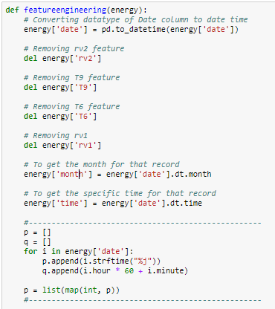
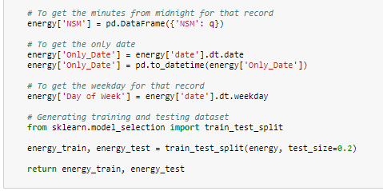
Creating Feature selection function for the dataset

Slide 24
Part 4: Prediction Algorithms:

Slide 25
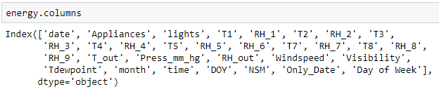
Base Feature:
After exploratory data analysis and feature engineering, we came up with the base features on which we have to build predictive models.
Following features are selected as a base line:

Slide 26
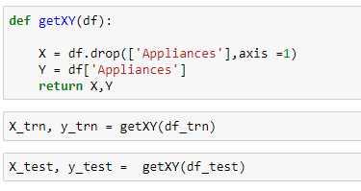
Training and Testing dataset
After performing feature engineering on our dataset, we will split it to training and testing datasets which will help us to build effective prediction model.

Slide 27
Benchmark Model:
Let’s select Linear regression model with base features.
We will use train and test datasets for the model performance.
Below are the performance metrics for these benchmark model.
Now let’s try to improve these performance with different models and feature selections.
 | Train | Test
MAE | 52.337 | 54.558
MAPE | 60.426 | 62.371
MSE | 8619.534 | 9472.858
R2 | 0.166 | 0.154

Slide 28
Performance Metrics of different models with base features.
Model | MAE_Test | MAE_Train | MAPE_Test | MAPE_Train | MSE_Test | MSE_Train | R2_Test | R2_Train | RMSE_Test | RMSE_Train | Testing Score(%) | Training Score(%) | Training Time
ExtraTreesRegressor | 30.063 | 0 | 28.617 | 0 | 4269.744 | 0 | 0.619 | 1 | 65.343 | 0.011 | 61.886 | 100 | 1.905
RandomForestRegressor | 33.515 | 13.044 | 32.716 | 12.613 | 5079.75 | 899.584 | 0.547 | 0.913 | 71.272 | 29.993 | 54.655 | 91.297 | 5.552
GradientBoostingRegressor | 47.03 | 43.204 | 50.692 | 47.657 | 7898.475 | 6406.759 | 0.295 | 0.38 | 88.873 | 80.042 | 29.493 | 38.021 | 3.543
MLPRegressor | 55.283 | 53.106 | 63.524 | 61.643 | 9390.062 | 8583.123 | 0.162 | 0.17 | 96.902 | 92.645 | 16.179 | 16.967 | 2.17
LinearRegression | 54.558 | 52.337 | 62.371 | 60.426 | 9472.858 | 8619.534 | 0.154 | 0.166 | 97.329 | 92.841 | 15.44 | 16.615 | 0.036
Ridge | 54.557 | 52.337 | 62.371 | 60.425 | 9472.847 | 8619.534 | 0.154 | 0.166 | 97.329 | 92.841 | 15.44 | 16.615 | 0.042
Lasso | 54.522 | 52.243 | 62.137 | 60.25 | 9510.086 | 8653.339 | 0.151 | 0.163 | 97.52 | 93.023 | 15.107 | 16.288 | 0.096
ElasticNet | 54.791 | 52.476 | 62.283 | 60.322 | 9662.773 | 8817.921 | 0.137 | 0.147 | 98.299 | 93.904 | 13.744 | 14.695 | 0.042

Slide 29
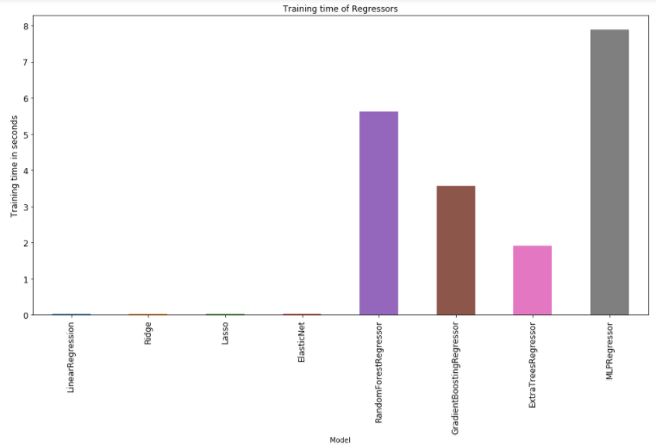
Training time performance

Slide 30
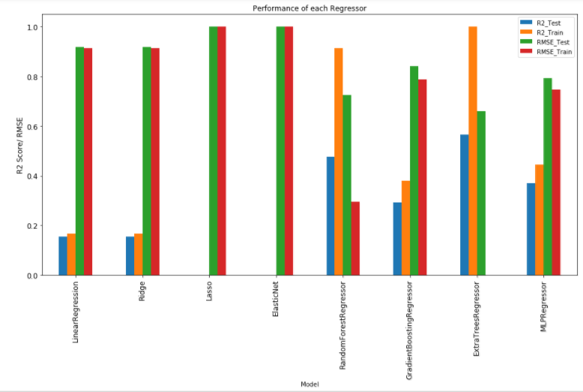
Performance of Regressors

Slide 31
Part 5: Feature selection

Slide 32
Different Approaches
Boruta
Tsfresh
Forward and Backward selection
RFE (Regressive features elimination)
Tpot
Base Features: (31)
'lights', 'T1', 'RH_1', 'T2', 'RH_2', 'T3', 'RH_3', 'T4', 'RH_4', 'T5','RH_5', 'RH_6', 'T7', 'RH_7', 'T8', 'RH_8', 'RH_9', 'T_out','Press_mm_hg', 'RH_out', 'Windspeed', 'Visibility', 'Tdewpoint','month', 'DOY', 'NSM', 'Day of Week’

Slide 33
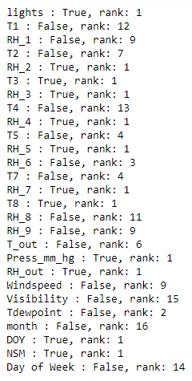
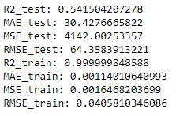
Boruta: Feature selection
Features using Boruta: (13)
'lights','RH_2','T3','RH_3','RH_4','RH_5','RH_7','T8','Press_mm_hg','RH_out','DOY','NSM'
Boruta only selects those columns whose rank is 1 and recommends to drop other ones.

Slide 34
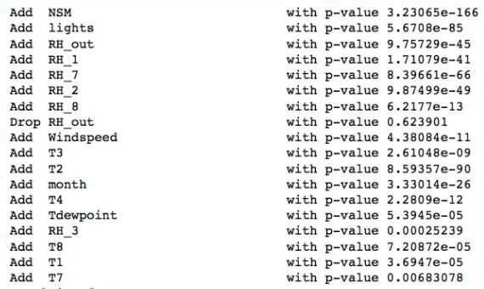
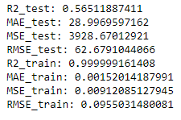
Forward and Backward selection
The forward and backward selection process evaluates the relevant features by calculating P-VALUES.
In our case it has recommended to add features which are as follows:
'NSM', 'lights', 'RH_1', 'RH_7', 'RH_2', 'RH_8', 'Windspeed', 'T3', 'T2', 'month', 'T4', 'Tdewpoint', 'RH_3', 'T8', 'T1', 'T7'

Slide 35
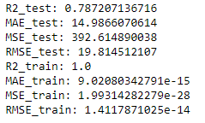
Tsfresh
TSFRESH deals with creation of calculated features based on individual entities present in the dataset.
In the First extraction the features calculated are more than 1200 and, we can further impute the results to get more relevant features, Or it has a extract_relevant_feature method which does all of the above in one step.

Slide 36
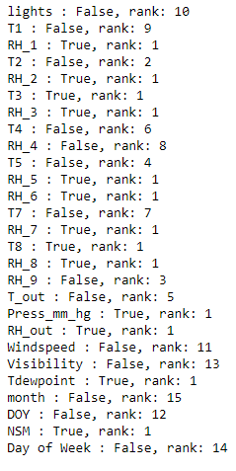
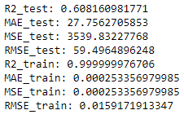
RFE:
RFE (RECURSIVE FEATURE ELIMINATION) is somewhat similar to boruta as it also ranks the features, but the good aspect using this method is we can select number of relevant features we want.
In this case we have chosen value of 13 so it returns the best 13 features present in the dataset.

Slide 37
Tpot:
TPOT is a Python Automated Machine Learning tool that optimizes machine learning pipelines using genetic programming.
TPOT will automate the most tedious part of machine learning by intelligently exploring thousands of possible pipelines to find the best one for your data.
Once TPOT is finished searching (or you get tired of waiting), it provides you with the Python code for the best pipeline it found so you can tinker with the pipeline from there.

Slide 38
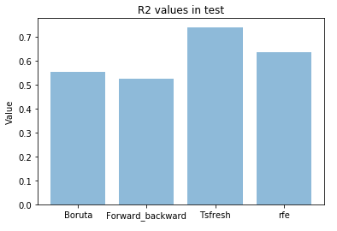
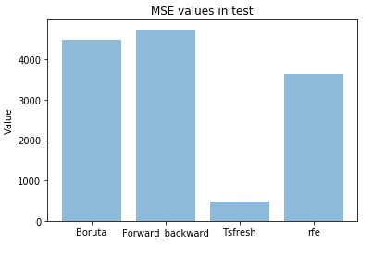
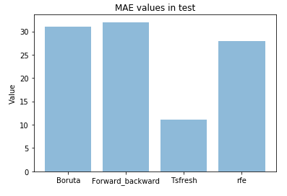
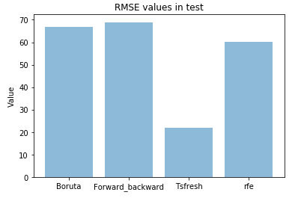
Performance Metrics : Feature Selections tools

Slide 39
Part 6: Model Validation

Slide 40
Model Validation approaches
Hyper Parameter tuning
Randomized Search
Grid Search
Cross Validation
Bias Variance Tradeoff
Regularization

Slide 41
Hyperparameter Tuning
Randomized Search:
The most important arguments in RandomizedSearchCV are n_iter, which controls the number of different combinations to try, and cv which is the number of folds to use for cross validation (we use 20 and 5 respectively). More iterations will cover a wider search space and more cv folds reduces the chances of overfitting, but raising each will increase the run time. Machine learning is a field of trade-offs, and performance vs time is one of the most fundamental.
Grid Search
Random search allowed us to narrow down the range for each hyperparameter. Now that we know where to concentrate our search, we can explicitly specify every combination of settings to try. We do this with GridSearchCV, a method that, instead of sampling randomly from a distribution, evaluates all combinations we define. To use Grid Search, we make another grid based on the best values provided by random search:
Notes:
The most important arguments in RandomizedSearchCV are n_iter, which controls the number of different combinations to try, and cv which is the number of folds to use for cross validation (we use 20 and 5 respectively). More iterations will cover a wider search space and more cv folds reduces the chances of overfitting, but raising each will increase the run time. Machine learning is a field of trade-offs, and performance vs time is one of the most fundamental.

Slide 42





Model Performance:
Randomized Search:
Grid Search:

Slide 43
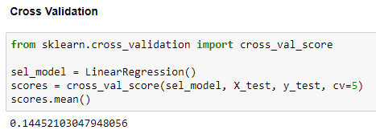
Cross Validation

Slide 44
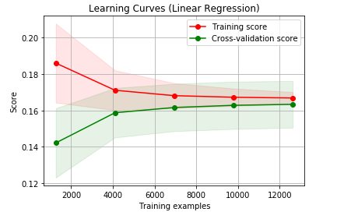
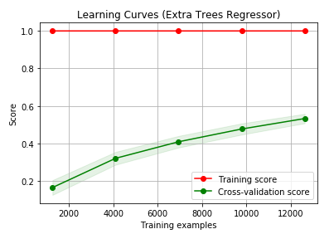
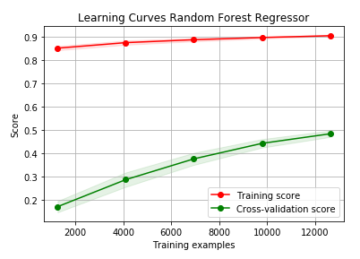
Bias Variance Tradeoff

Slide 45
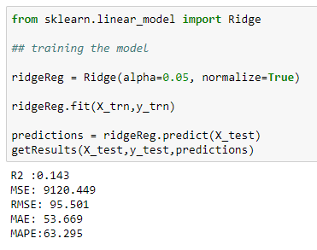
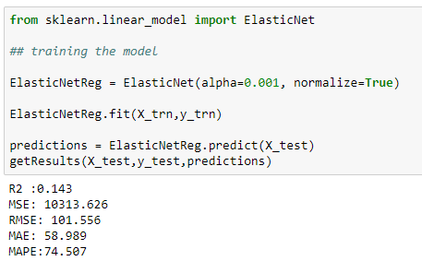
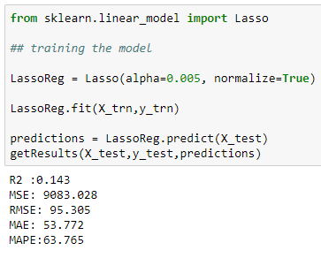
Regularization
Lasso
Ridge
ElasticNet

Slide 46
Part 7: Final Pipeline

Slide 47
Appliance Energy Utilization Prediction Model
Exploratory Data Analysis
Feature Engineering
Different Prediction model
Feature selection
Model Validation
We have to automate the whole process from data injection to final prediction model.
We will automate these with the customized functions.

Slide 48
Approach
Create a Jupyter notebook.
Install all required libraries and packages
Import data
Create feature engineering function which will perform the required feature engineering tasks on the imported dataset.
Create a function to generate the training and testing datasets.
Create function for the feature selection.
Create function for model Implementation.
Create function for model performance evaluation.
Create function for hyperparameter tuning.
Final function to execute the whole preccess in a go.

Slide 49
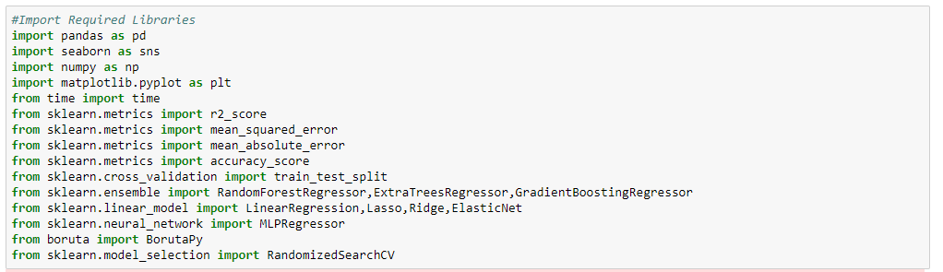

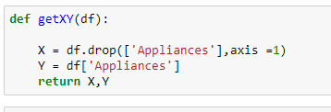
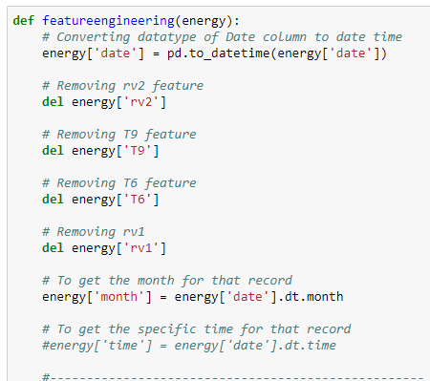
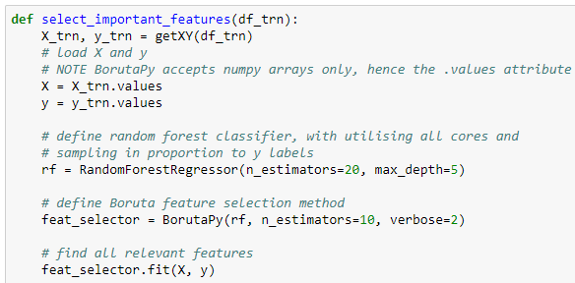

Slide 50

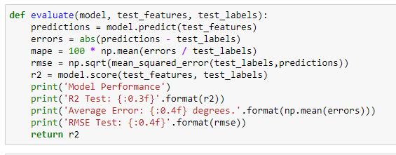
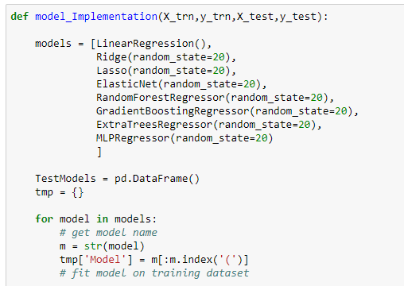
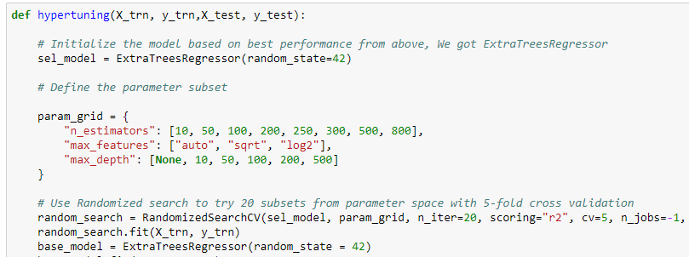

Slide 51
